Slide 1
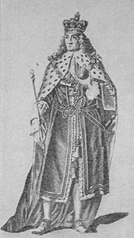
“Tuesday, Dec. 23, 1755 - And is this all the world can give even a King? All the grandeur it can afford? A blanket of ermine round his shoulders, so heavy and cumbersome he can scarce move under it! An huge heap of borrowed hair, with a few plates of gold and glittering stones upon his head! Alas, what a bauble is human greatness! And even this will not endure.” Wesley’s Journal
George II in His Robes of State

Slide 2
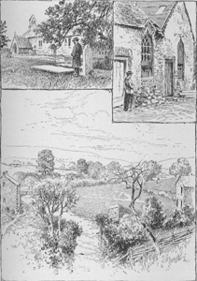
The Grave of the First Methodist Martyr.
The Old Chapel at Hay.
The Scene of the Martyrdom.

Slide 3
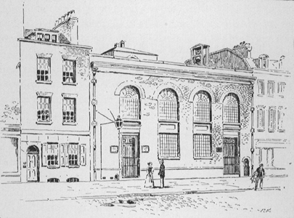
West Street Chapel

Slide 4
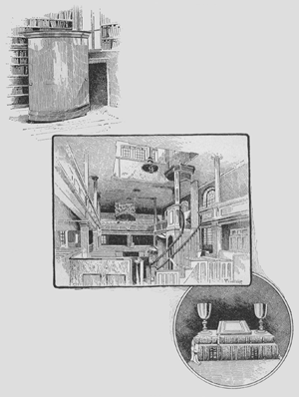
Wesley’s Portable Pulpit
West Street Chapel,
Interior
Old Huguenot
Communion Cups

Slide 5
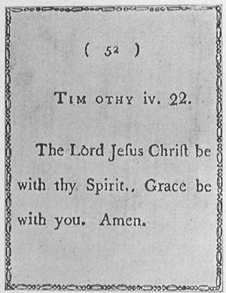
A Methodist Playing Card

Slide 6
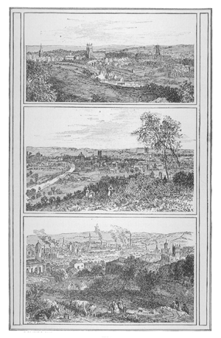
The Conference Cities
Manchester in 1728.
Leeds in the early part of
the eighteenth century.
Bristol from Brandon Hill.

Slide 7
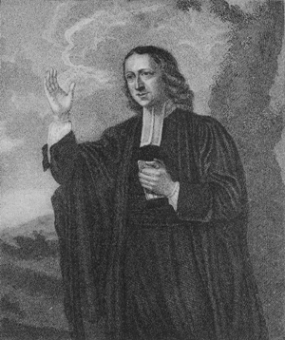
John Wesley at the age of sixty-three

Slide 8
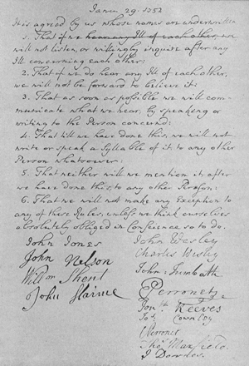
Facsimile of an agreement made by the preachers in 1752.

Slide 9
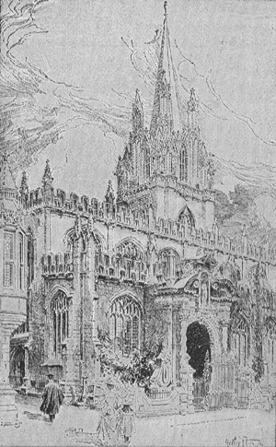
St. Mary’s Church, Oxford

Slide 10
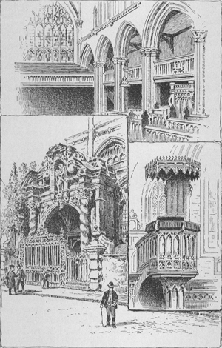
Glimpses of St. Mary’s, Oxford
Porch, with statue of
the Virgin.
The undergraduates’
gallery.
The pulpit.

Slide 11
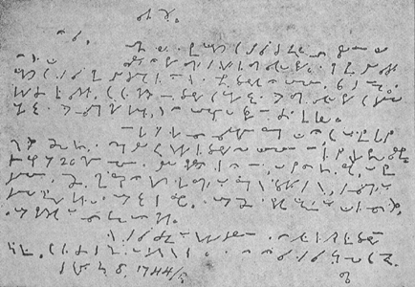
John Wesley’s Shorthand Writing

Slide 12
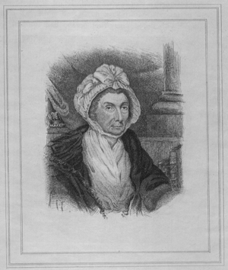
Selina, Countess of Huntingdon
The Patron of Whitefield.

Slide 13
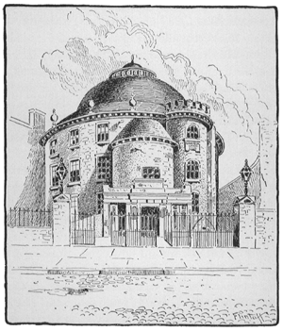
Lady Huntingdon’s Chapel in Spa Fields

Slide 14
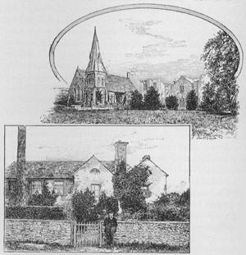
Trevecca College.
Opened by Lady Huntingdon,
1768, now controlled by the Calvinistic Methodists.
Trevecca Farmhouse.
Here John Wesley, John Fletcher,
George Whitefield stayed when they
went to open Trevecca College, 1768.

Slide 15
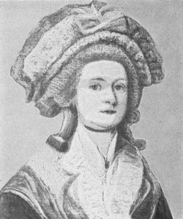
Mrs. John Wesley
Mrs. Vazeille, to whom
John Wesley was married, 1751

Slide 16
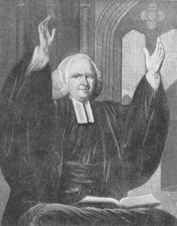
The Reverend George Whitefield, A.M.
Chaplain to the Countess of Huntingdon.

Slide 17
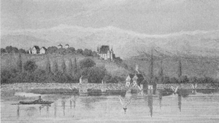
Nyon, Where John Fletcher Was Born

Slide 18
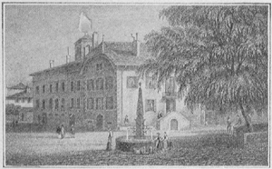
The Birthplace of John Fletcher

Slide 19
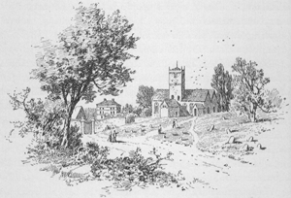
Madeley Parish Church and Vicarage
Where Rev. John Fletcher was vicar.

Slide 20
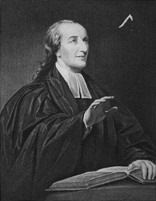
The Rev. John Fletcher, Vicar of Madeley
“Wesley’s Designated Successor.”

Slide 21
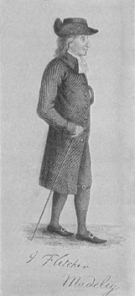
From the rare
engraving in
Centenary Hall,
London.

Slide 22
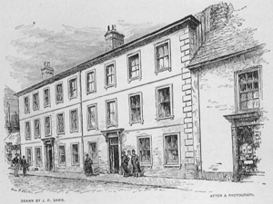
Town House of Walter Churchey, Brecon
Dr. Thomas Coke was born in the house adjoining.

Slide 23
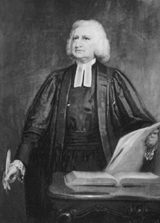
Charles Wesley

Slide 24
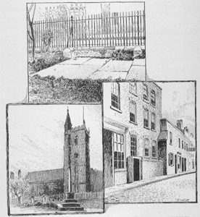
Grave of Charles
Wesley’s Children, St. James Churchyard.
St. James Church, Bristol.
Charles Wesley’s House, Bristol.

Slide 25
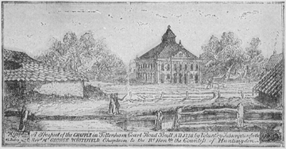
Whitefield’s Tabernacle, 1756

